Slide 1
Chapter 6 General Trees
6.1 Definitions and Terminology
6.2 General Tree ADT
6.3 General Tree Implementations
  Parent Pointer
  Array-based Children List
  Linked Children List
  Array-based Left-child/Right-sibling
  Linked Left-child/Right-sibling
  Sequential Implementation

Slide 2
General Trees (1)

Slide 3
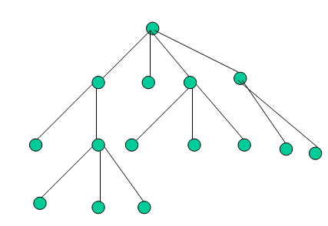
General Trees (2)
A tree T is a finite set of nodes such that there is one designated _{特定的} node r called the root of T, and the remaining nodes in (T –{r}) are partitioned into k≥0 disjoint subsets T₁, T₂, ..., T_{k}, each of which is a tree, and whose roots r₁, r₂, ..., r_{k}, respectively, are children of r.
root
r
r1
r2
r3
r4
Notes:
Designated /’dezigneitid/

Slide 4
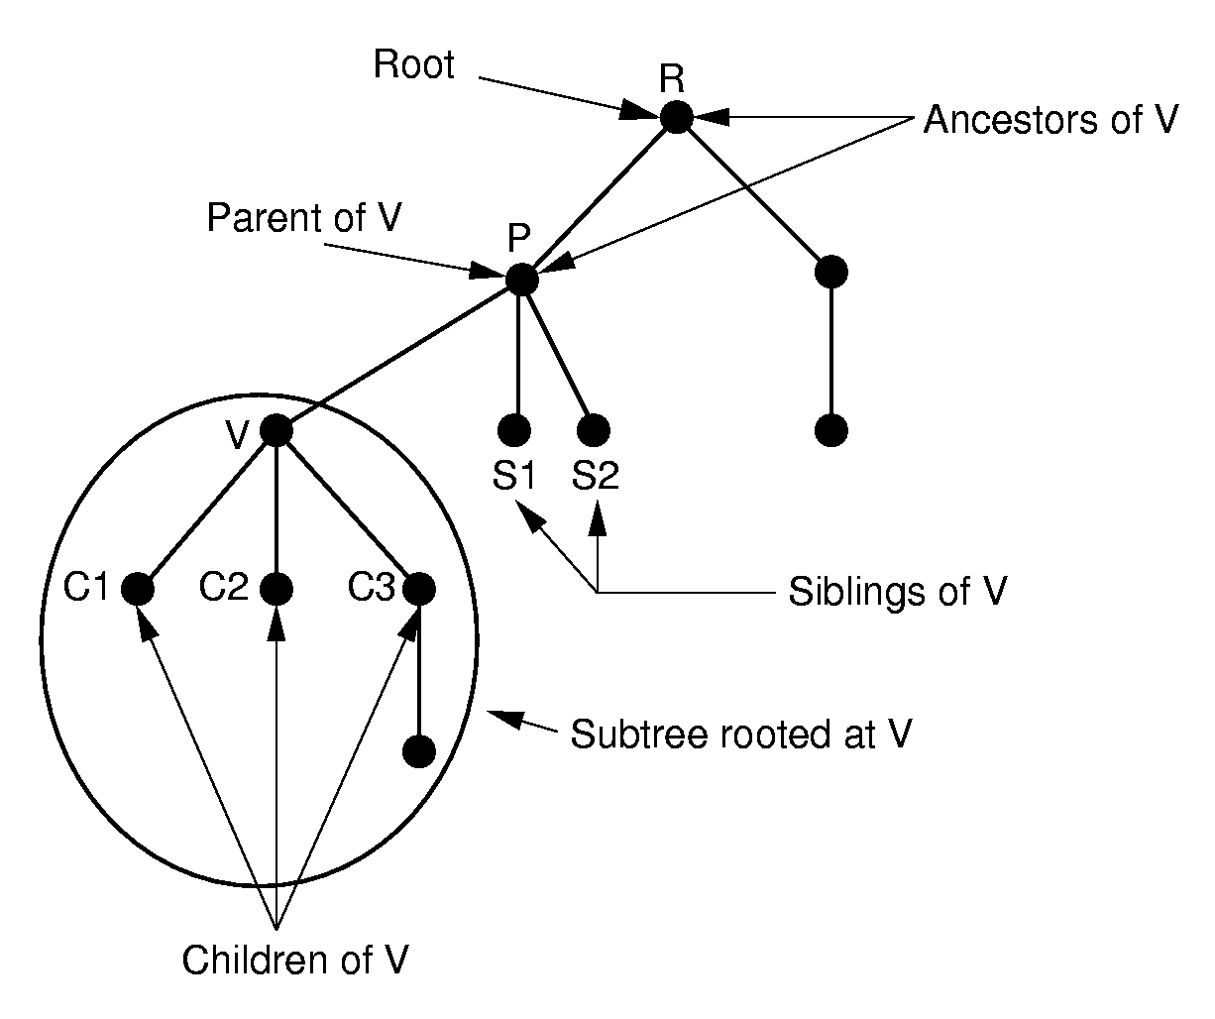
General Trees (3)

Slide 5
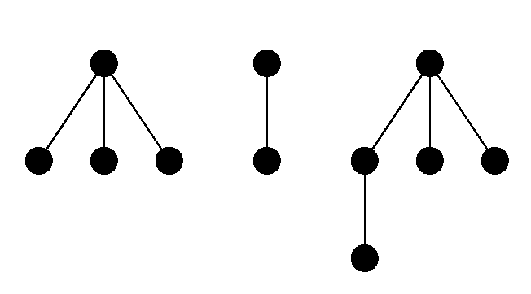
Forest
A forest is a collection of general trees
Notes:
The result is essentially a dynamic implementation for the left child/right sibling representation for general trees.

Slide 6
General Tree Traversal
Preorder traversal
  Vist the root
  Preorder traversal of all sub-trees from left to right
Postorder traversal
  Postorder traversal of all sub-trees from left to right
  Vist the root

Slide 7
General Tree Traversal(2)
Preorder traversal:
R
RADEBCFGHK
A
B
C
D
E
F
Postorder traversal:
DEABGHKFCR
G
H
K

Slide 8
Chapter 6 General Trees
6.1 Definitions and Terminology
6.2 General Tree ADT
6.3 Binary Tree Implementations
  Parent Pointer
  Array-based Children List
  Linked Children List
  Array-based Left-child/Right-sibling
  Linked Left-child/Right-sibling
  Sequential Implementation

Slide 9
General Tree Node ADT
// General tree node ADT
template <class Elem> class GTNode {
public:
GTNode(const Elem&); // Constructor
~GTNode(); // Destructor
Elem value(); // Return value
void setValue(Elem&); // Set value
  bool isLeaf(); // TRUE if is a leaf
  GTNode* parent(); // Return parent
  GTNode* leftmost_child(); // First child
  GTNode* right_sibling(); // Right sibling
  //insert first child
  void insert_first(GTNode<Elem>* n);
  //insert right sibling
  void insert_next(GTNode<Elem>* n);
  void remove_first(); // Remove first child
  void remove_next(); // Remove sibling
};
Notes:
What API is necessary.

Slide 10
General Tree ADT
// General tree ADT
template <class Elem>
class GenTree
{
public:
void clear(); // Free the nodes
GTNode* root(); // Return the root
void print(GTNode*);
};

Slide 11
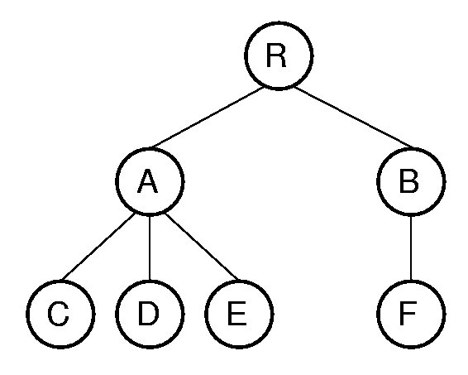
Print by Preorder traversal
template <class Elem>
void GenTree<Elem>:: print(GTNode<Elem>* subroot)
{
if(subroot == NULL) return;
if (subroot->isLeaf()) cout << "Leaf: ";
else cout << "Internal: ";
cout << subroot->value() << "\n";
for (GTNode<Elem>* temp = subroot->leftmost_child();
temp != NULL; temp = temp->right_sibling())
print(temp);
}
Internal: R
Internal: A
Leaf: C
Leaf: D
Leaf: E
Internal: B
Leaf: F
subroot
temp
Notes:
Traversal: RACDEBF
Compare with the binary tree.

Slide 12
Chapter 6 General Trees
6.1 Definitions and Terminology
6.2 General Tree ADT
6.3 General Tree Implementations
  Parent Pointer
  Array-based Children List
  Linked Children List
  Array-based Left-child/Right-sibling
  Linked Left-child/Right-sibling
  Sequential Implementation

Slide 13
General Tree Implementation
root
? How to present a node
? How to present the edges among
nodes (relationship)

Slide 14
Chapter 6 General Trees
6.1 Definitions and Terminology
6.2 General Tree ADT
6.3 General Tree Implementations
  Parent Pointer
  Array-based Children List
  Linked Children List
  Array-based Left-child/Right-sibling
  Linked Left-child/Right-sibling
  Sequential Implementation

Slide 15
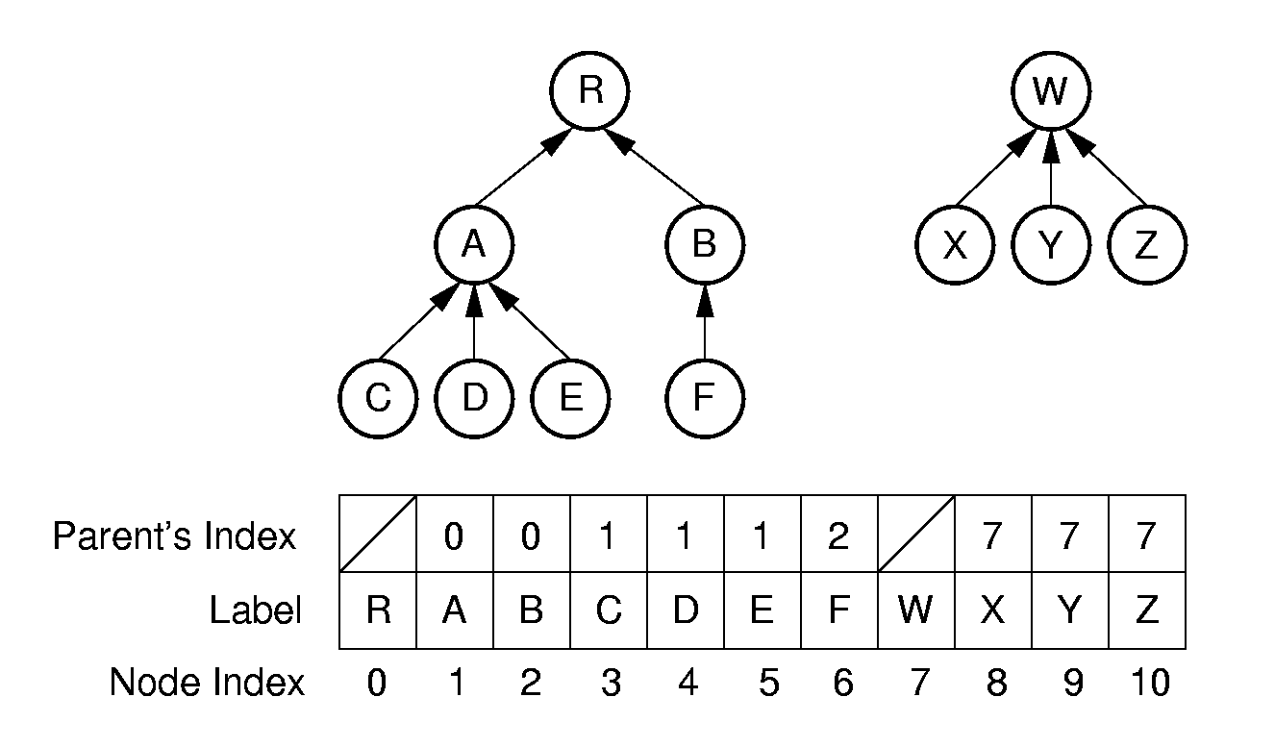
Parent Pointer Implementation(1)
array
present one or more trees in an array

Slide 16
Parent Pointer Implementation(2)
class ParPtrTree
{
private:
int * array;
int size;
public:
Gentree(int);
~Gentree(){delete[] array; }
0
1
2
3
4
5
6
array

Slide 17
Parent Pointer Implementation(3)
public:
int FIND(int) const; // find root of a node
bool differ(int, int); //judge if two nodes are in a same tree
void UNION(int, int); //merge two sub tree
};
Easy to locate parent, hard to locate children
array

Slide 18
Parent Pointer Implementation(4)
// find root of a node
int ParPtrTree ::FIND(int curr) const {
while (array[curr]!=ROOT) curr = array[curr];
return curr; // At root
}
cur
ROOT = -1
cur
array
Notes:
Examples of equivalence classes:
Connected components in graphs
Point clustering

Slide 19
Parent Pointer Implementation(5)
// Return TRUE if nodes in different trees
bool ParPtrTree::differ(int a, int b) {
int root1 = FIND(a); // Find root for a
int root2 = FIND(b); // Find root for b
return root1 != root2; // Compare roots
}
root1
root2
b
a
array
Notes:
Examples of equivalence classes:
Connected components in graphs
Point clustering

Slide 20
Parent Pointer Implementation(6)
//merge two sub tree
void ParPtrTree ::UNION(int a, int b) {
int root1 = FIND(a); // Find root for a
int root2 = FIND(b); // Find root for b
if (root1 != root2) array[root2] = root1;
}
root1
root2
Union(3,8)
b
a
array
0
Notes:
Examples of equivalence classes:
Connected components in graphs
Point clustering

Slide 21
Application
The parent pointer representation is often used to maintain a collection of disjoint sets（不相交集/并查集 ）:
  To determine if two objects are in the same set.
    differ(int, int)
  To merge two sets together
    UNION(int, int)

Slide 22
Improve performance (1)
The efficiency of find(), differ () , UNION() in average case depends on the average depth of the nodes in the tree.

Slide 23
Improve performance (2)
Methods to reduce the average depth:
  Path Compression
  Weighted union rule

Slide 24
Method 1 to Reduce Average Depth –
Path Compression
Reduce the average depth of nodes by path compression:
The path compression happens when Find(x) is called: let the nodes in the path from root to x directly connect to the root.
0
0
1
3
1
Find (5)
5
3
2
4
2
4
5
Notes:
Path compression is used to process equivalence (H, E).

Slide 25
Method 1 to Reduce Average Depth –
Path Compression. Cont.
int Gentree::FIND(int curr) const {
if (array[curr] == ROOT) return curr;
return FIND(array[curr]);
}
array[curr] =
0
FIND(5)=FIND(3)=FIND(1)=FIND(0)=0
0
array[5]=FIND(3)
1
Find (5)
array[3]=FIND(1)
1
3
2
3
array[1] = FIND(0)
curr
5
2
4
4
5
array[1]=0
0
1
1
3
3
0
1
0
3
0
array[3]=0
0 1 2 3 4 5
0 1 2 3 4 5
array[5]=0
Notes:
Path compression is used to process equivalence (H, E).

Slide 26
Method 2 to Reduce Average Depth—
Weighted union rule
Weighted union rule:
  Join the tree with fewer nodes to the tree with more nodes to keep the height of tree small.
1
3
3
+
=
Average depth =
(0+1+1+1+2)/5=1
2
4
5
1
5
4
2

Slide 27
Method 2 to Reduce Average Depth—
Weighted union rule. Cont.
Weighted union rule:
  Join the tree with fewer nodes to the tree with more nodes to keep the height of tree small.
1
3
1
+
=
Average depth =
(0+1+1+2+2)/5=6/5
2
4
5
2
3
4
5

Slide 28
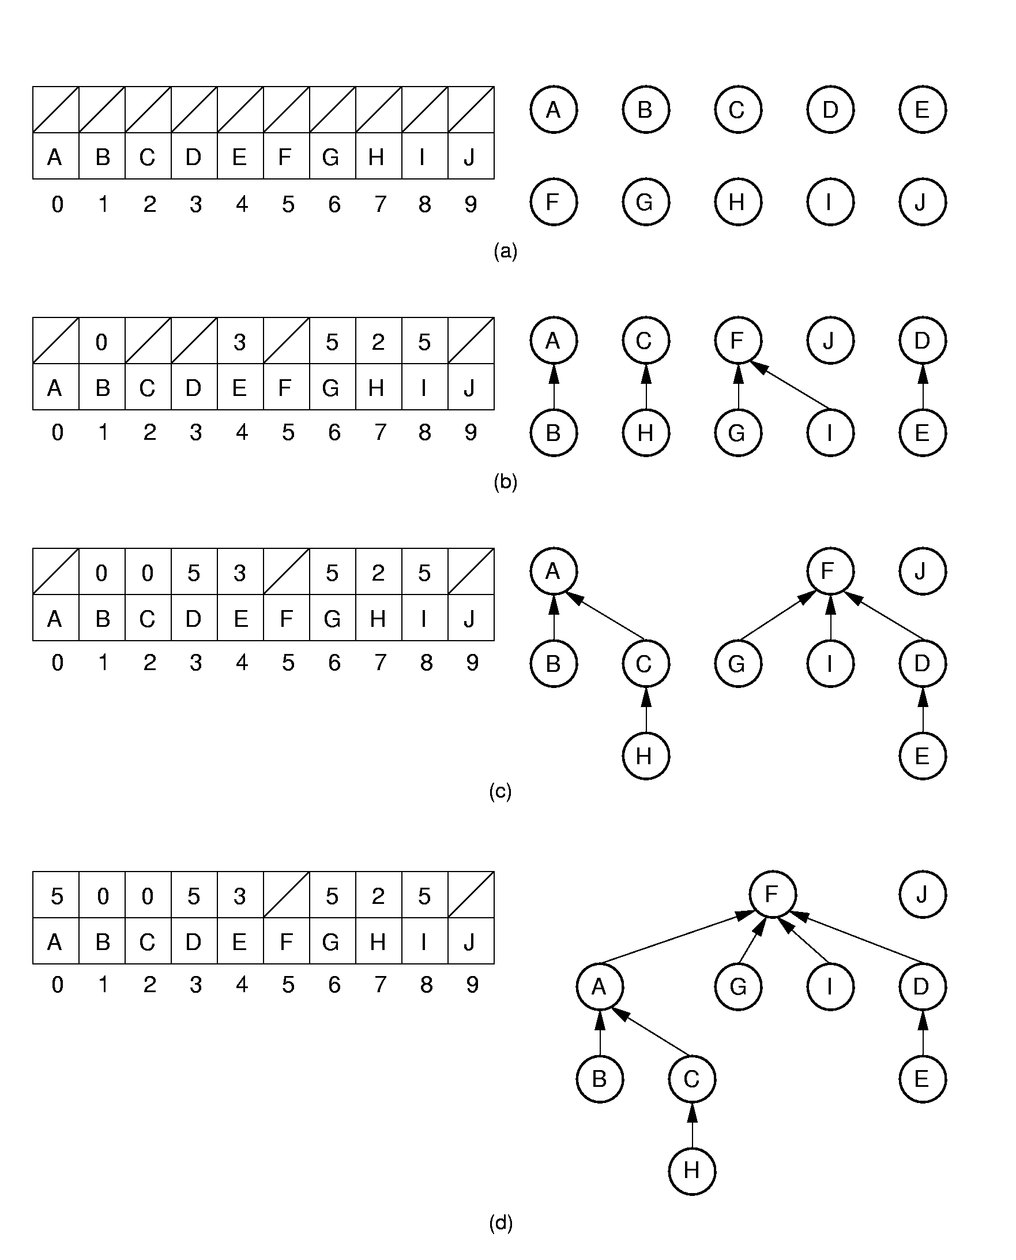
Method 2 to Reduce Average Depth—
Weighted union rule. Cont.
Union (A,B) (C,H) (G,F) (D,E) (I,F) (H,A) (E,G)

Slide 29
Method 2 to Reduce Average Depth—
Weighted union rule. Cont.
Union(H,E)
Notes:
(d) shows the result of processing equivalence (H, E).

Slide 30
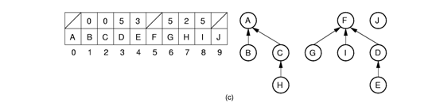
Put together
root1 = FIND(H);
root2 = FIND(E);
array[?] = ?;
Path Compression
Weighted union rule
Union(H,E)
root2
J
root1
F
A
G
I
D
E
B
C
H
Notes:
Path compression is used to process equivalence (H, E).

Slide 31
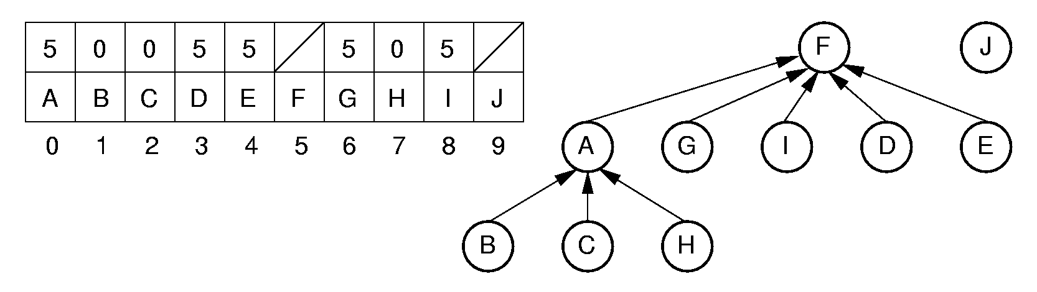
Put together
root2
J
root1
F
A
G
I
D
E
B
C
H
root1 = FIND(H);
root2 = FIND(E);
array[?] = ?;
Path Compression
Weighted union rule
Union(H,E)
array[root1] = root2;
Notes:
Path compression is used to process equivalence (H, E).

Slide 32
Chapter 6 General Trees
6.1 Definitions and Terminology
6.2 General Tree ADT
6.3 General Tree Implementations
  Parent Pointer
  Array-based Children List
  Linked Children List
  Array-based Left-child/Right-sibling
  Linked Left-child/Right-sibling
  Sequential Implementation

Slide 33
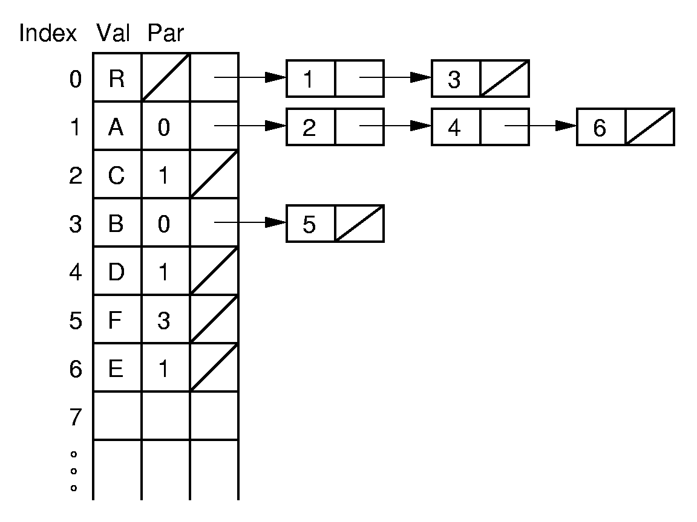
Array-based Children List
Easy to locate parent and children
Notes:
The next several slides show various possible implementations for general trees.
A key gauge for the quality of these representations is how well they perform the key tasks of left-child, right-sibling, and parent. This representation is poor for finding the right sibling of a node.

Slide 34
Chapter 6 General Trees
6.1 Definitions and Terminology
6.2 General Tree ADT
6.3 General Tree Implementations
  Parent Pointer
  Array-based Children List
  Linked Children List
  Array-based Left-child/Right-sibling
  Linked Left-child/Right-sibling
  Sequential Implementation

Slide 35
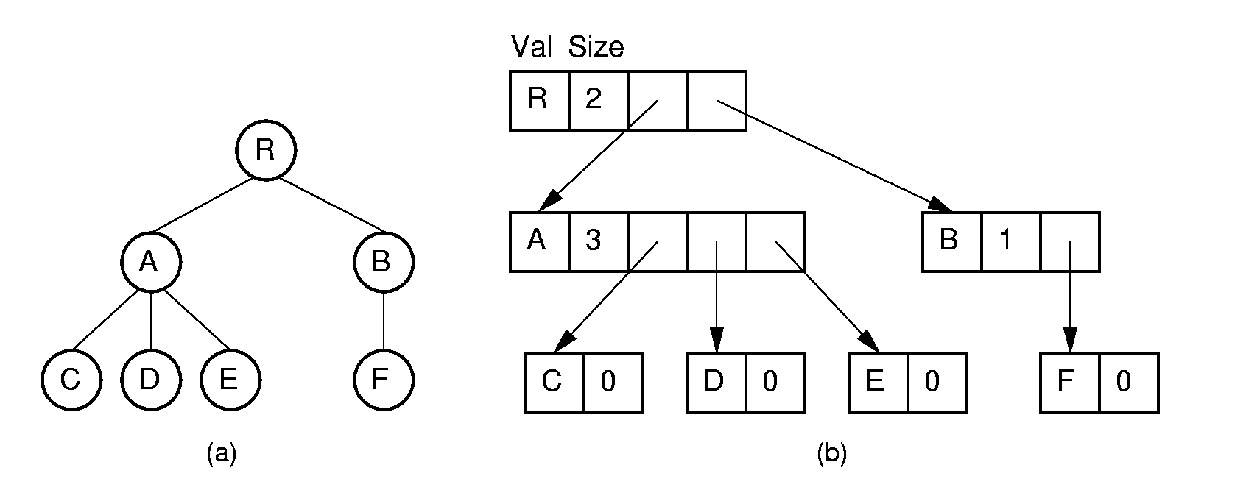
Linked Children list (1)
Dynamic node implementations
Hard to define the variable node structure
Hard to extend the tree
Notes:
Essentially an array-based list of children.

Slide 36
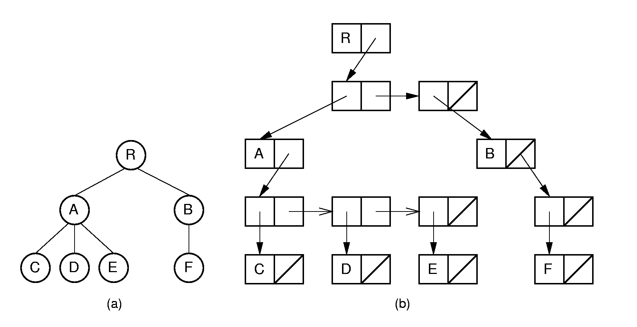
Linked Children list (2)
struct Node_E {
Elem e;
Node_P* children;
};
struct Node_P {
Node_E* node;
Node_P* next;
};
Notes:
Essentially a linked list of children.

Slide 37
Chapter 6 General Trees
6.1 Definitions and Terminology
6.2 General Tree ADT
6.3 General Tree Implementations
  Parent Pointer
  Array-based Children List
  Linked Children List
  Linked Left-child/Right-sibling
  Array-based Left-child/Right-sibling
  Sequential Implementation

Slide 38
Linked Left-child/Right-sibling
R
A
R
D
B
A
B
C
E
C
F
D
E
F
G
G
H
K
H
K
A General tree can be represented as a binary tree in this way

Slide 39
Converting to a Binary Tree(1)
R
R
A
A
B
C
D
B
D
E
F
E
C
G
H
K
F
G
H
Left-child/Right-sibling
K

Slide 40
Converting to a Binary Tree(2)
A forest can also be converted to binary tree
A
E
G
A
森林与二叉树对应
B C D
F
H I
B E
J
C
F
G
树与二叉树对应
A
G
D
H
E
B
H
I
F
树根相连
C
I
J
D
J
Notes:
The result is essentially a dynamic implementation for the left child/right sibling representation for general trees.

Slide 41
Chapter 6 General Trees
6.1 Definitions and Terminology
6.2 General Tree ADT
6.3 General Tree Implementations
  Parent Pointer
  Array-based Children List
  Linked Children List
  Linked Left-child/Right-sibling
  Array-based Left-child/Right-sibling
  Sequential Implementation

Slide 42
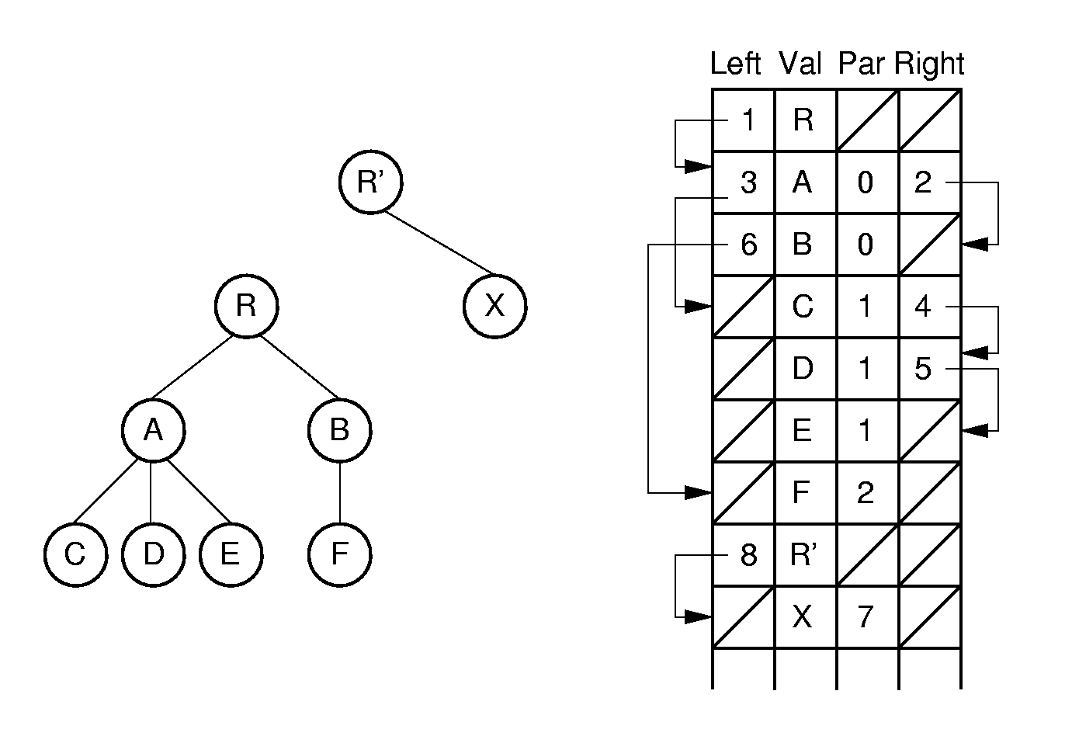
Array-based Left-child/Right-sibling(1)
0
1
2
3
4
5
6
7
8
Easy for Parent(), leftmost_child() and right_sibling()
Notes:
Note: Two trees share the same array.

Slide 43
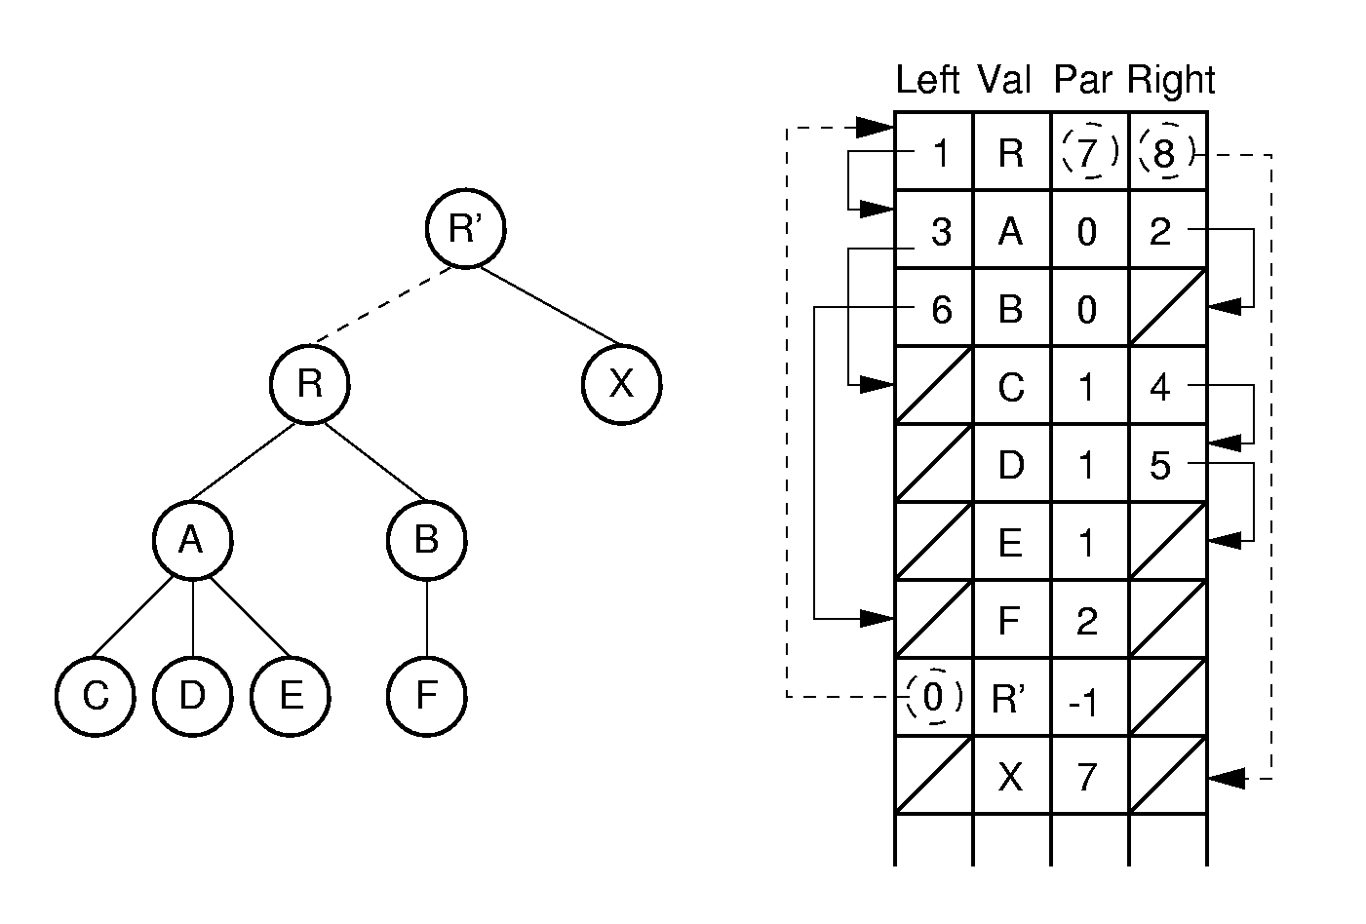
Array-based Left-child/Right-sibling(2)
0
1
2
3
4
5
6
7
8
Notes:
Here, the two trees are joined together. Few links need to be adjusted in the implementation to support this join action.

Slide 44
Chapter 6 General Trees
6.1 Definitions and Terminology
6.2 General Tree ADT
6.3 General Tree Implementations
  Parent Pointer
  Array-based Children List
  Linked Children List
  Array-based Left-child/Right-sibling
  Linked Left-child/Right-sibling
  Sequential Implementation

Slide 45
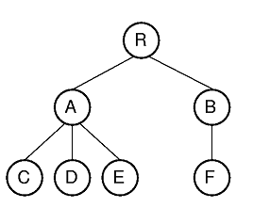
Sequential Implementations
How to store a series of node values with the minimum information needed to reconstruct the tree structure?
  Useful for archiving trees on disk.
Notes:
This example refers to the tree of Figure 6.16.

Slide 46
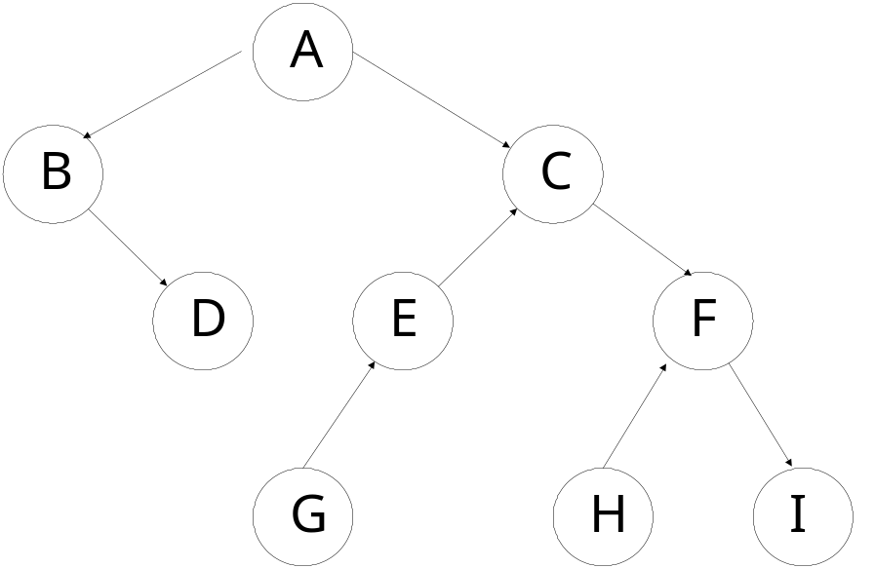
Sequential Implementations of Binary Tree (1)
Example1:
ABDCEGFHI
For binary trees, use a symbol to mark null links.
AB/D//CEG///FH//I//
preorder traversal

Slide 47
Sequential Implementations of Binary Tree (2)
Example2:
mark nodes as leaf or internal.
AB/D’CEG’/FH’I’
preorder traversal

Slide 48
Sequential Implementations of General Tree
Example 3: For general trees, mark the end of each subtree.
RAC)D)E))BF)))
1. Print root
2. For each subtree of root do
Print the subtree
5. End for
6. Print ‘)’
preorder traversal
Notes:
The first example includes two “/” marks because the example tree is not full. Cost is one additional bit per node.
The second example refers to the general tree of Figure 6.3.

Slide 49
Exercises
P225 6.17,6.18, 6.19
Given a tree, how to write program to output the sequential string like “RAC)D)E))BF)))”?
  void PrintTree(GTNode* root);
Given a sequential string like “RAC)D)E))BF)))”, how to build a tree?
  bool BuildTree (char* str,
  int& len, GTNode*& root) ;

Slide 50
Thanks! Questions?

